Slide 1

The Physical Web with Vending Machine
GUIDE:PROF A.R.DESHPANDE
SPONSER: MARVELL PVT LTD
MENTOR : MR. ANUJ DESHPANDE
AMRUTA RANADE B120054223
SEJAL KHATRI B120054336
KEVIN KAUL B120054333

Slide 2
Contents :
PROBLEM STATEMENT.
ABSTRACT.
PROJECT GOALS AND OBJECTIVES.
INTRODUCTION
PROBLEMS.
SOLUTIONS.
ARCHITECTURAL DESIGN.
HARDWARE AND SOFTWARE REQUIREMENTS.
DATA FLOW.
STATE DIAGRAM.

Slide 3
ERD DIAGRAM.
RELATED MATHEMATICS.
ALGORITHMS USED.
USAGE SCENARIO.
MAJOR CONSTRAINTS.
APPLICATIONS .
FUTURE SCOPE.
REFERENCES.
BIBLIOGRAPHY.
IMPLEMENTATION
CONCLUSION.

Slide 4
PROBLEM STATEMENT :
To Automate vending machine functionalities for vendors and enabling easy accessibility for users through online payment and establishing a physical interface with the help of beacons.

Slide 5
ABSTRACT :
A vending machine is a machine that dispenses items such as snacks, bever- ages to customers automatically, after the customer inserts currency or credit into the machine. But nowadays paying in cash has become difﬁcult and cannot be fulﬁlled every time. Therefore we provide a platform for the vending machine functionalities and management to be handled by cloud using Internet of things. With this approach online payment for vending machines can be made possible and the stock record is maintained on the cloud for dynamically updating the vendor. In addition to this the users are notiﬁed about the presence of the vending machine in nearby area using Web Bluetooth API.

Slide 6
Project goals and objectives :
Goals :
Interactive vending machine with cashless payment and cloud connectivity.
Enhanced User experience by using visualization for dynamic data change through web applications.
Project Objectives:
User authentication and a simple signup/sign in form.
To create a URL redirection and a simple CMS for the webpages.
Database creation and connectivity.
Developing Vendor page and user page.
Add Payment functionality using Paytm API.
Study the parameters for Vending Machine.
Connectivity between vending machine and cloud.
Testing the Application.

Slide 7

INTRODUCTION
Physical web is an open approach to enable quick and seamless interactions with physical objects and locations.
Everything is a tap away.
See what’s useful around you.
Any object or place can broadcast content.

Slide 8
What is a vending machine?
A vending machine is a machine that dispenses items such as snacks, beverages to customers automatically, after the customer inserts currency or credit into the machine.

Slide 9
Problems Faced :
Presently the people use coins or paper money while operating the vending machines.
Due to this there arises a problem when the user does not seem to have exact change with him.
Vendors don’t come to know about the stock required in the vending machines when excess usage is done.

Slide 10
Solutions :
Due to the problems faced by both the users and the vendors we propose the following solutions :
Online (cashless) payments are available for the users for easy purchase of items.
Vendors are well informed about the stock management of the machine and they are also aware of the customers past transactions.

Slide 11
This project consists of three phases-
Firmware and hardware.
Cloud Communication.
Front end work.

Slide 12
1. Firmware :
This phase consists of the debugging, soldering of wires and working in .c
Device drivers consists of Bluetooth Low Energy devices wherein we simulate
the beacons .
The motors (Stepper motor), LED’s are tested and debugged for use.
The knit board (wifi enabled board) is installed in the vending machine through serial port interfacing .
The knit board is in turn connected to the Bluetooth Low Energy(BLE) using an AT protocol for interfacing .

Slide 13
2. Cloud Communication :
AWS Platform for cloud communication Message broker used(intermediary program)
REST Protocol(runs on top HTTP)
Mqtt protocol : to publish and subscribe .
https protocol to publish.
Both protocols are supported through IPV4 and IPV6
Device updates.
Offline behavior.
Stockpiling.
Network failures.

Slide 14
REST API (HTTP protocol).
3 . Front end :
The frontend of the project will be made using ReactJS library.
It includes two parts namely:
User part.
Vendor part.

Slide 15
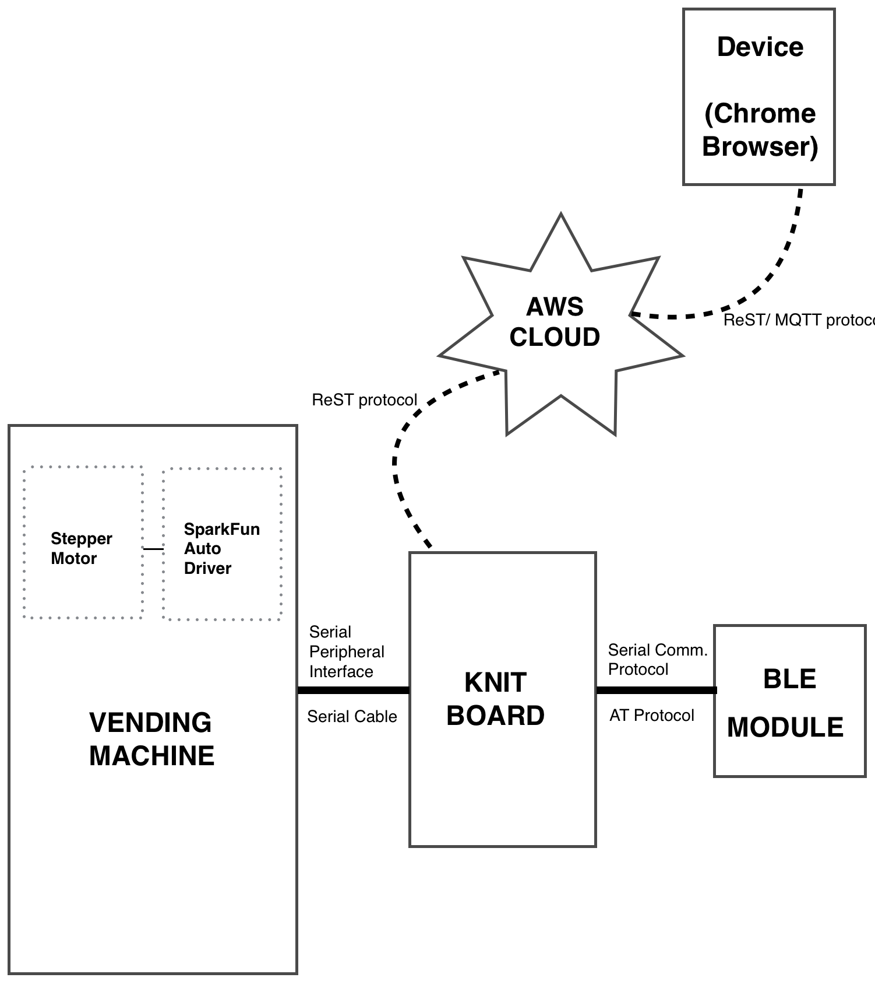
Architectural Design

Slide 16
Description :
In this diagram the knit board is interfaced with the vending machine through a serial peripheral cable.
The vending machine consists of stepper motor and drivers used in the process of interfacing with the knit board.
A Bluetooth Low Energy(BLE) module is connected to the knit board through a serial communication AT protocol.
The vending machine communicates with the AWS cloud using the REST protocol and the cloud is connected to the chrome browser through a MQTT protocol.

Slide 17
Hardware and Software Requirements :
HARDWARE RESOURCES :
1. Beacons (Eddy stone Bluetooth 4.0 protocol).
2. Vending machines.
3. Knit board(Wi-Fi-enabled micro controller).
4. Mobile phone.(Android(Version: 6.0) or iOS(version: 8)).
SOFTWARE RESOURCES :
Platform : Amazon Web Services.
1. Operating System: Linux(Ubuntu16.04).
2. IDE: Eclipse (Mars).(3.0)
3. Programming Language : C , JavaScript.
4. API: Web Bluetooth(4.0)
5. AWSIOT Device SDK JS (Version 1.0.12)
6. Google chrome Browser (version :53.0.2785.143)

Slide 18
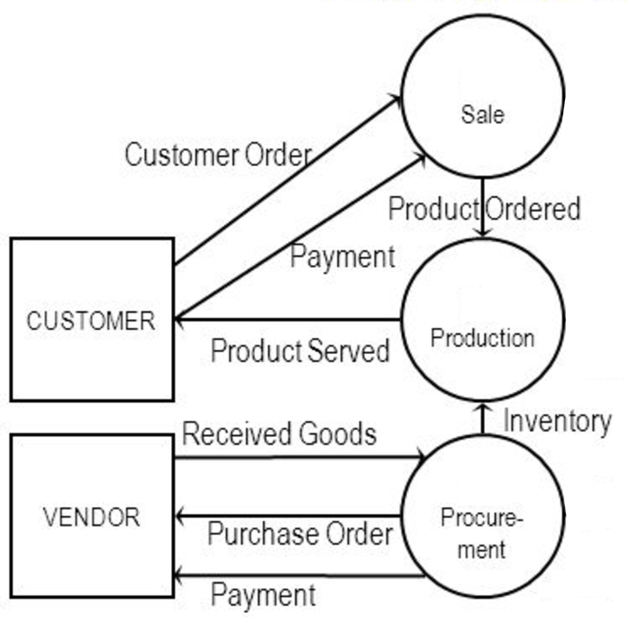
Data Flow :

Slide 19
Data Flow:
We will have a Wi-Fi enabled board on the vending machines which will send beacons to the mobile phones having Bluetooth in their vicinity.
The user will receive a notification which will contain a URL flashed by the beacon on his cellphone along with suggestions for other products.
The user will hence find and approach the vending machine and click on the desired product on his cellphone.

Slide 20
Data flow :
The transaction is carried out using the online payment gateways or mobile wallet and is recorded and stored in the cloud which is used for future transactions.
The vending machine then dispenses the product ordered by the user.
The vendor will have an updated list of the stock remaining in the cloud.

Slide 21
Data Flow :
The transaction is carried out using the online payment gateways or mobile wallet and is recorded and stored in the cloud which is used for future transactions.
The vending machine then dispenses the product ordered by the user.
The vendor will have an updated list of the stock remaining in the cloud.

Slide 22
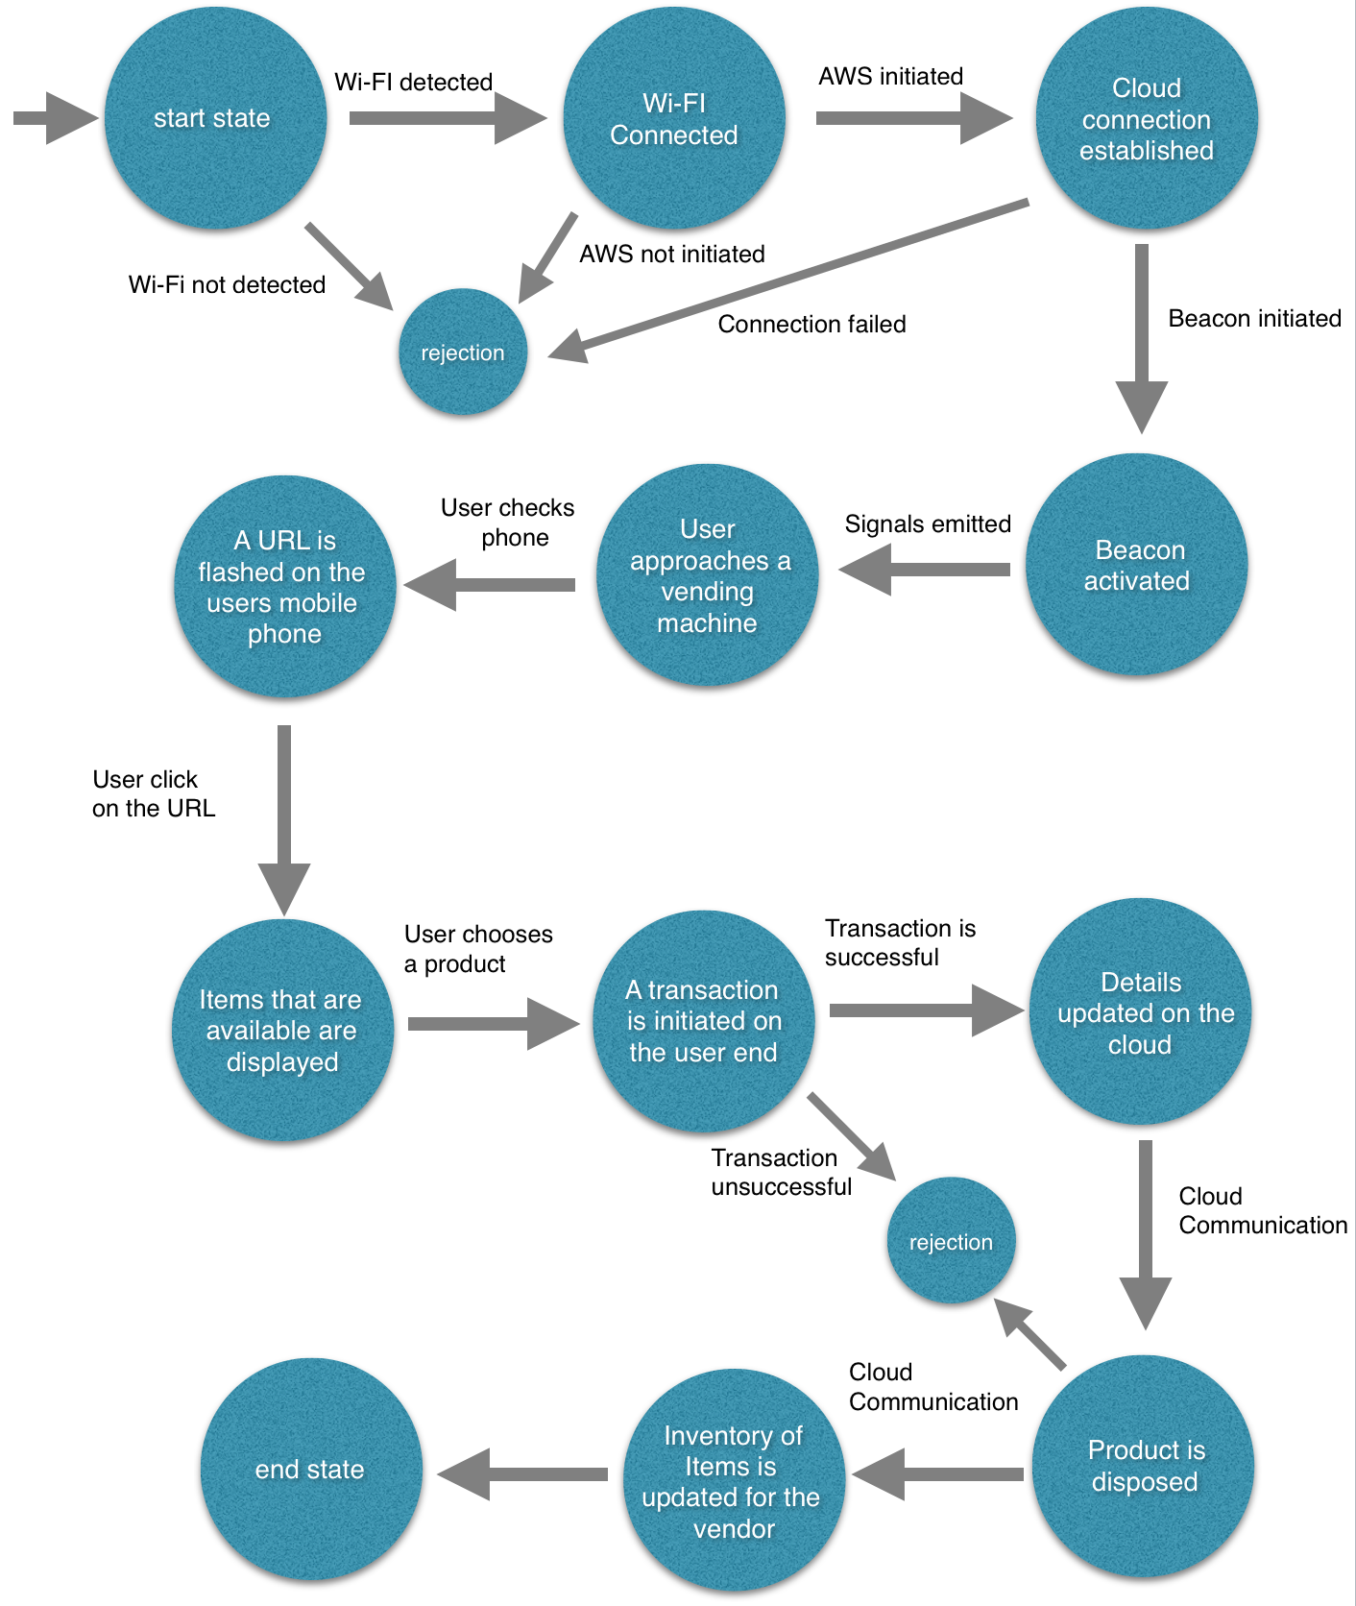
State Diagram :

Slide 23
Description:
This diagram describes the behaviour of the system.
State1: Initiallyisthestartstate,wheretheavailabilityofwiﬁconnectionischecked.
State2: If Wi-Fi is detected then system displays the message Wi-Fi connected and if not then the system rejects the user.
State3: Next it checks whether the AWS is initiated or not. Once it is, then the cloud communication is established.
State4: Once this communication is established, the beacons are activated and the signals are emitted from them to the user’s phone.

Slide 24
Description:
State5: The user then approaches the vending machine and simultaneously a URL is ﬂashed on the user’s mobile phone.
State6: Once the user clicks on the URL available items are displayed on his phone. When the user chooses a product ,a transaction is initiated on the user end.
State7:If the transaction is successful, the details are updated on the cloud otherwise are rejected.
State8: After updation the product is dispensed from the vending machine. And the inventory of items is updated at the vendor side. Hence the process states end.

Slide 25
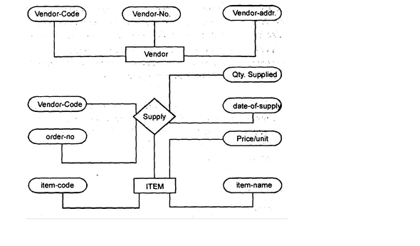
Entity Relationship Diagram
This diagram depicts the relationship between different entities. We have shown the relationship and functioning taking place between the user and the vendor respectively.

Slide 26
Related Mathematics :
Let S be the solution system ,
S ={ s , e, X, Y, F, DD, NDD , sc, fc — shmem}
where,
s = start state (Wi-ﬁ interfacing)
e = end state (Product delivered and status recorded )
X = Input set = {Physical address, users choice}
Y = Output set {Product requested , suggestions}
Functions : Fme + Ffriend.
Fme = Main functions.
Fme = (ﬁn , fout,initiate,detect,connect).
Fin : Faddress , Fchoice Fout:Fdispose , Fsuggest

Slide 27
Finitiate :{Fconnectwiﬁ ,Fﬂashurl,Fconnectaws }
Fdetect: Fdetectwiﬁ
Fconnect:{ Fcw ,Fcaws}
Fcw :refresh Wi-Fi connection
Fcaws : refresh AWS connection
Ffriend = inbuilt functions.
Ffriend = (fproc , fcloud).
Non Deterministic Data : Physical address of user’s device and location.

Slide 28
Deterministic Data :Items(as ﬂashed on users device).
Success Conditions: Valid input(i.e. valid user choice)is given and the product is dispensed successfully and proper internet availability.
Failure Conditions: Invalid input( i.e. invalid user choice) given and product not dispensed along with poor internet availability

Slide 29
Algorithms :
Algorithm used is Dijkatra’s algorithm.Dijkstra’s algorithm is an algorithm for ﬁnding the shortest paths between nodes in a graph, which may represent, for example, road networks.
For a given source node in the graph, the algorithm ﬁnds the shortest path between that node and every other.
It can also be used for ﬁnding the shortest paths from a single node to a single destination node by stopping the algorithm once the shortest path to the destination node has been determined.

Slide 30
Example :
For example, if the nodes of the graph represent cities and edge path costs represent driving distances between pairs of cities connected by a direct road, Dijkstra’s algorithm can be used to ﬁnd the shortest route between one city and all other cities. As a result, the shortest path algorithm is widely used in network routing protocols, most notably IS-IS and Open Shortest Path First (OSPF).
It is also employed as a subroutine in other algorithms such as Johnson’s. Explanation: The cost which we will be using will not just be the cost of the path but the added priority of the product The cost = distance + Priority Mapped Value(depending on product) .
So the product with highest priority that is which is higher demand will be given lower value which will reduce the cost and that path will be preferred.
Accordingly we can calculate and let the vendor know which machine he should approach ﬁrst.

Slide 31
Usage scenario :
There are two actors involved in the use case diagram:
1. User
2. Vendor
The user is the person who approaches the vending machine to buy a product and the vendor is the person who sells various products by regularly stocking them up in the vending machine. The relationship between them is similar to a buyer and seller.
Use Case 1: User connects to AWS cloud.
Use Case 2:Vendor connects to AWS cloud.
Use Case 3:User interacts with the vending machine through cloud.

Slide 32
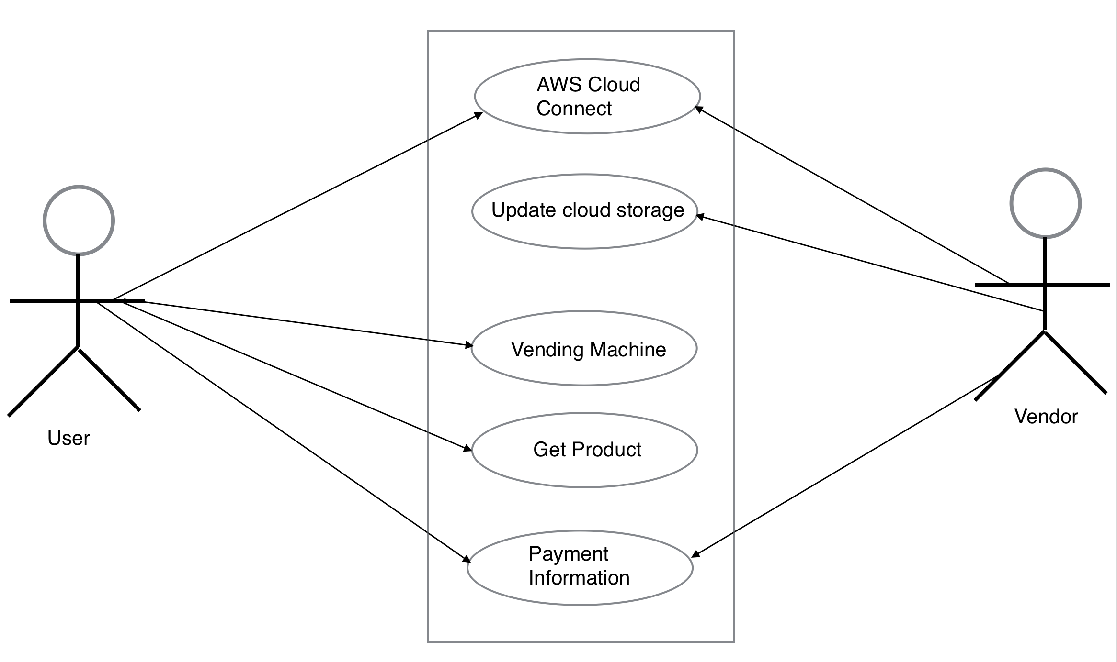

Slide 33
Description :
The project consists of two actors. They are, the user and the vendor. There are ﬁve functions namely
AWS cloud connection.
Updating the cloud storage.
Usage of the vending machine.
Get the product.
payment information.
The user and the vendor both interact by using the cloud connection. Both of them also have access to the payment information. The user also uses the vending machine to get the product. On the other hand the vendor is able to update the cloud storage.

Slide 34
Major constraints :
Need of Google chrome browser: The user should have Google chrome browser to take advantage of this service as currently the web Bluetooth technology is supported by only Google chrome.
Availability of Wi-Fi connections: The vending machine should be placed in a location where there is Wi-Fi availability, for smoother connection and faster product delivery. If the internet ﬂuctuates then user will have to wait for product and this in turn leads to decrease in the product sale.
Location of the vending machines: Vending machine should be located in such a place where it is accessible to the people (the Bluetooth range).

Slide 35
Applications :
Final product will be used at public places like railway stations,airports,malls, bus stands and can be used by private vendors too.

Slide 36
Future Scope:
The future scope of this project is the availability of online payments at every vending machine and an expand in the Web Bluetooth Technology.
This project will consist of creating a platform for vending machine functionalities and management to be handled by cloud using Internet of things. Online payment for vending machines is made possible and stock record is maintained on the cloud for dynamically updating the vendor.
Functionality mechanism is concentrated on removing the cash payment barrier on the vending machine

Slide 37
REFERENCES :
Zaruba, G.v., S. Basagni, and I. Chlamtac. ”Bluetrees-scatternet Formation to Enable Bluetooth-based Ad Hoc Networks.” ICC 2001. IEEE International Conference on Communications. Conference Record (Cat. No.01CH37240) .
Linthicum, David S. ”The Technical Case for Mixing Cloud Computing and Manufacturing.” IEEE Cloud Computing 3.4 (2016): 12-15.
Massuthe,P.,andK.Schmidt. ”Operating Guidelines-anAutomata-Theoretic FoundationfortheService-OrientedArchitecture.”FifthInternationalConference on Quality Software (QSIC’05).
Sneps-Sneppe, Manfred, and Dmitry Namiot. ”On Physical Web Models.” 2016InternationalSiberianConferenceonControlandCommunications(SIBCON) (2016).
Namiot, Dmitry, and Manfred Sneps-Sneppe. ”The Physical Web in Smart Cities.” 2015 Advances in Wireless and Optical Communications (RTUWO) (2015).
Lee, Jin-Shyan, Yu-Wei Su, and Chung-Chou Shen. ”A Comparative Study of Wireless Protocols: Bluetooth, UWB, ZigBee, and Wi-Fi.” IECON 2007 33rdAnnualConferenceoftheIEEEIndustrialElectronicsSociety(2007).
Simeone, Osvaldo, and Haim H. Permuter. ”Source Coding with Delayed Side Information.” 2012 IEEE International Symposium on Information Theory Proceedings (2012).
Zhang, Qi, Lu Cheng, and Raouf Boutaba. ”Cloud Computing: State-of-theart and Research Challenges.” Journal of Internet Services and Applications 1.1 (2010).

Slide 38
BIBLIOGRAPHY
https://aws.amazon.com/rds/mysql/
https://serverless.com/framework/
https://aws.amazon.com/api-gateway/
http://docs.aws.amazon.com/lambda/latest/dg/welcome.html
https://serverless.com/

Slide 39
IMPLEMENTATION
Simple Web Interface created for user to communicate with the amazon cloud using AWS IOT Service.

Slide 40
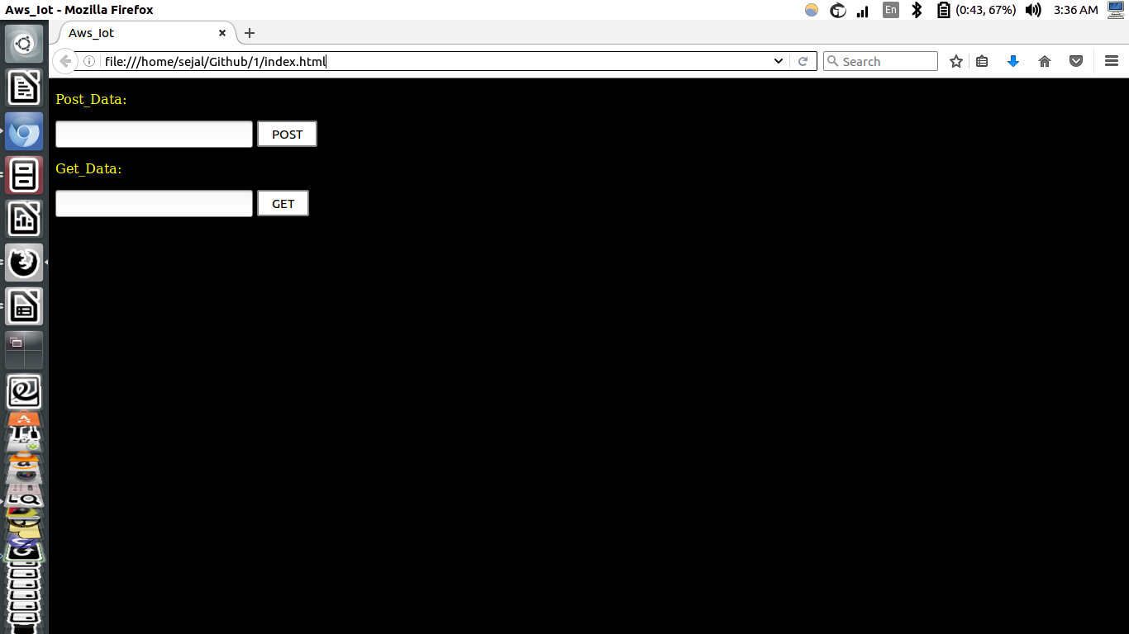
IMPLEMENTATION

Slide 41
THANK YOU!

